Slide 1
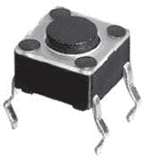
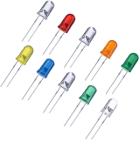
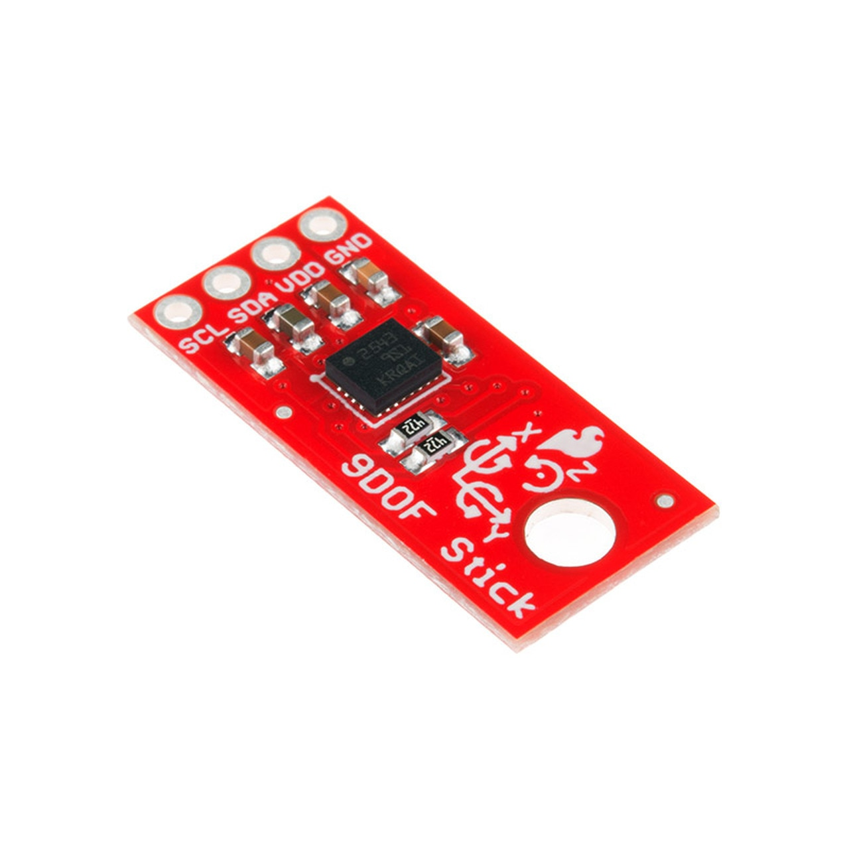
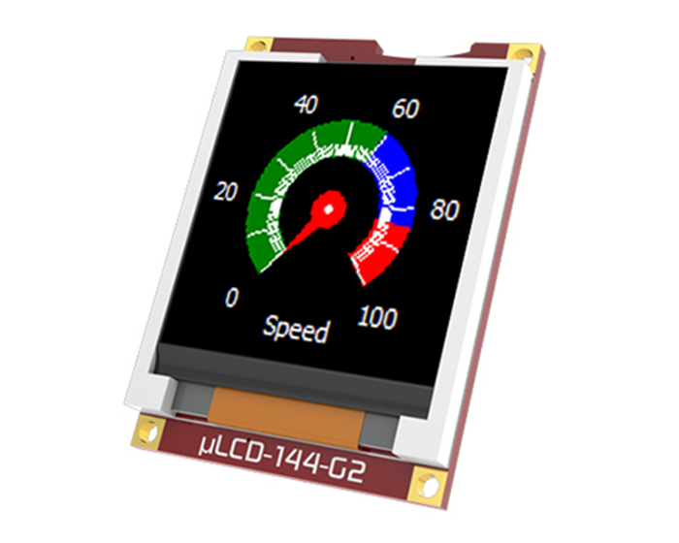
MQTT Broker
MQTT
MQTT
UART
Native API
Home Assistant
Server
Mbed LPC1768
ESP32
WIFI
Physical Connection
IO Devices

